Slide 1

Computer Organization & Architecture
Lab2 CPU&Memory
    Nedaa Hussein Ahmed
    nh1179@fayoum.edu.eg

Slide 2
Characters
In addition to numbers, computers must be able to handle non numeric text information consisting of characters.
➢ Characters can be letters of the alphabet, decimal digits, punctuation marks, and so on. They are represented by codes that are usually eight bits long. One of the most widely used such codes is the (ASCII) code.

Slide 3
Characters cont...
➢ ASCII stands for American Standard Code for Information Interchange.
➢ Computers can only understand numbers, so an ASCII code is the numerical representation of a character such as 'a' or '@' or an action of some sort.

Slide 4
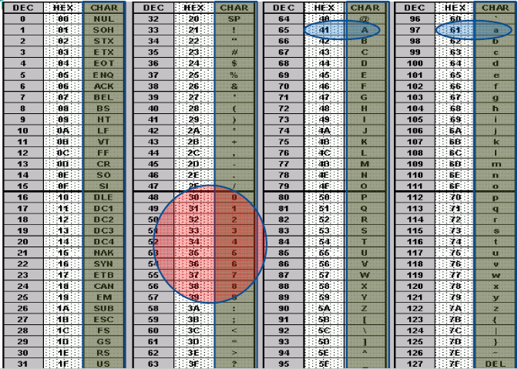
ASCII Code

Slide 5
Notes
➢ The ASCII code for the small characters is = the ASCII code for the Capital characters + 20h.
ex:
The ASCII code for ”a”= The ASCII code for “A”+20h
= 41h+20h =61h
➢ The ASCII code for the decimal number=the decimal
number +30h
ex:
The ASCII code for number 7=7+30h=37h

Slide 6
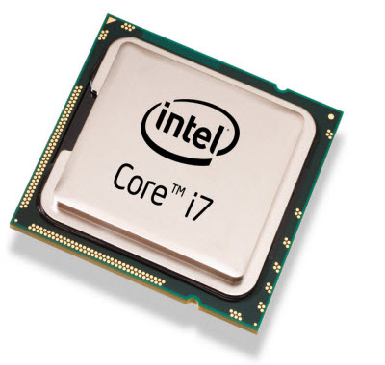
Microprocessor
➢ The computer you are using to read this presentation uses a microprocessor to do its work.
The microprocessor is the heart of any normal computer.
➢ A microprocessor -- also known as a CPU [central processing
unit] is a complete computation engine
that is fabricated on a single chip.

Slide 7
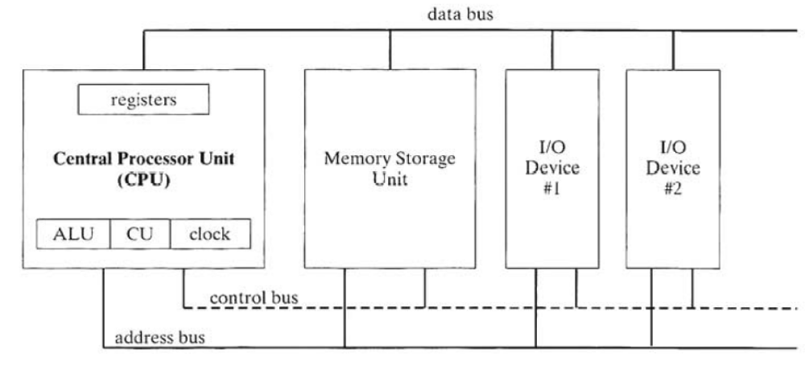
Basic Microcomputer Design
The central processor unit (CPU) is where all the calculations and logic operations take place.
It contains a limited number of storage locations called registers, a high-frequency clock, a control unit, and an arithmetic logic unit .

Slide 8
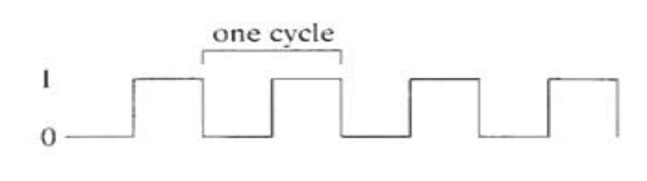
Basic Microcomputer Design cont...
The clock: synchronizes the internal operations of the CPU with
other system components.
A machine instruction requires at least one clock cycle to execute, and a few require in excess of 50 clocks (ex. multiply).
The control unit (CU): coordinates the sequencing of steps involved in executing machine instructions.
The arithmetic logic unit (ALU): performs arithmetic operations such as addition and subtraction, and logical operations such as AND, OR, and NOT.

Slide 9
Basic Microcomputer Design cont...
➢ The memory storage unit : where instructions and data are held
while a computer program is running. The storage unit receives
requests for data from the CPU, transfers data from random access memory (RAM) to the CPU, and transfers data from the CPU into memory.

Slide 10
Basic Microcomputer Design cont...
➢ A bus is a group of parallel wires that transfer data from one part of the computer to another. The system bus of a computer usually consists of three different busses :
  1. The data bus, transfers instructions and data between the CPU and memory.
  2. The control bus, uses binary signals to synchronize the actions of all devices attached to the system bus (read or write).
  3. The address bus, holds the addresses of instructions and data when the currently executing instruction transfers data between the CPU and memory.

Slide 11
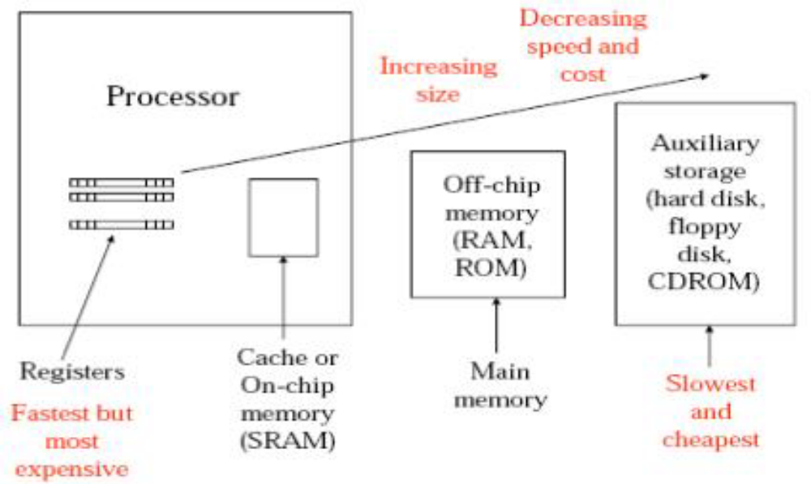
Memory hierarchy

Slide 12
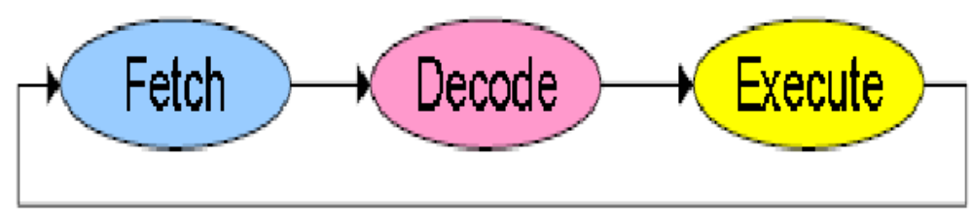
Instruction Execution Cycle
➢ The execution of a single machine instruction can be divided into a sequence of individual operations called the instruction execution cycle.
➢ When the CPU executes an instruction using a memory operand, it must calculate the address of the operand, place the address on the address bus, wait for memory to get the operand and so on.
➢ When the CPU executes a single machine instruction, three primary operations are always necessary: fetch , decode, and execute. Two more steps are required when the instruction uses a memory operand: fetch operand, and store output operand.

Slide 13
Instruction Execution Cycle cont...
• Fetch: The control unit fetches the instruction , copying it from memory into the CPU and increments the program counter (PC).
• Decode: The control unit determines the type of instruction to be executed . It passes zero or more operands to the arithmetic logic unit (ALU) and sends signals to the ALU that indicate the type of operation to be performed.

Slide 14
Instruction Execution Cycle cont...
• Fetch operands: If a memory operand is used , the control unit initiates a read operation to retrieve the input operand from memory.
• Execute: The arithmetic logic unit executes the instruction, sends its data to the output operand, and updates status flags providing information about the output.
• Store output operand: If the output operand is in memory, the control unit initiates a write operation to store the data.

Slide 15
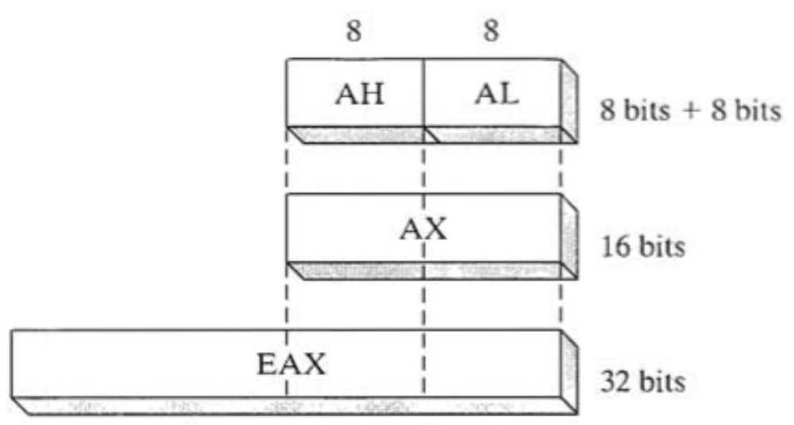
Basic Program Execution Registers
Registers are high-speed storage locations directly inside the CPU, designed to be accessed at much higher speed than conventional memory.
There are eight general-purpose registers, six segment registers,
a register that holds processor status flags (EFLAGS) and an
instruction pointer (EIP).

Slide 16
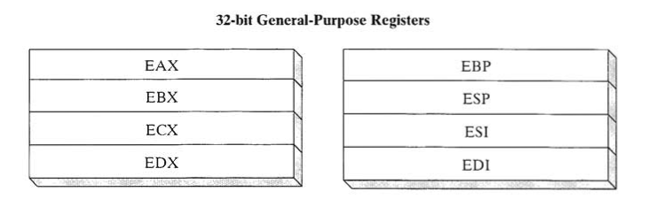
General-purpose registers
General-purpose registers are primarily used for arithmetic
and data movement.

Slide 17
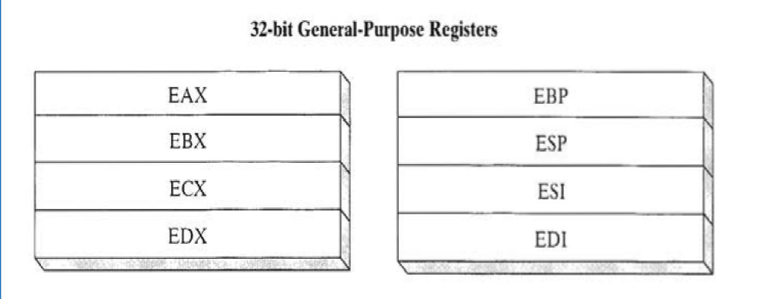
General-purpose registers cont...
Specialized Uses Some general-purpose registers have specialized uses:
  EAX(Extended Accumulator) is automatically used by multiplication and division instructions.
  The CPU automatically uses ECX(Extended Count) as a loop counter.

Slide 18
General-purpose registers cont...
Specialized Uses Some general-purpose registers have specialized uses:
  ESP(Extended Stack Pointer) addresses data on the stack (a system memory structure). It should never be used for ordinary arithmetic or data transfer.
  ESI and EDI(Extended Source Index and Extended Destination Index) are used by high-speed memory transfer instructions.

Slide 19
Segment Registers & IP
The segment registers are used as base locations for pre-assigned memory areas called segments.
  CS (code segment) - points at the segment containing the current program.
  DS (Data Segment) - generally points at segment where variables are defined.
  ES (extra segment register) - it's up to a coder to define its
  usage.
  SS (stack Segment) - points at the segment containing the stack.
The EIP, or instruction pointer register contains the address of the next instruction to be executed

Slide 20
EFLAGS Register
The EFLAGS (or just Flags) register consists of individual
binary bits that either control the operation of the CPU or
reflect the outcome of some CPU operation.
There are machine instructions that can test and manipulate the processor flags.
A flag is set when it equals 1: it is clear (or reset) when it
equals 0.

Slide 21
EFLAGS Register cont...
➢ The Carry flag (CF) is set when the result of an unsigned arithmetic operation is too large to fit into the destination .
➢ The Overflow flag (OF) is set when the result of a signed arithmetic operation is either too large or too small to fit into the destination.
➢ The Sign flag (SF) is set when the result of an arithmetic or logical operation generates a negative result.
➢ The Zero flag (ZF) is set when the result of an arithmetic or logical operation generates a result of zero.
➢ The Auxiliary Carry flag (AC) is set when an arithmetic operation causes a carry from for example bit 3 to bit 4 in an 8-bit operand .
➢ The Parity flag (PC) sums the number of bits that are set in a number, and indicates whether the sum is odd or even.

Slide 22
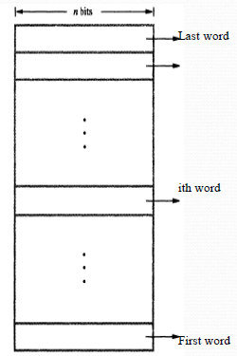

Memory locations and addresses
➢ Number and character operands, as well as
instructions, are stored in the memory of a
computer.
We will now consider how the memory is
organized:
➢ The memory consists of many millions of storage cells, each of which can store a bit of information having the value 0 or 1.
➢ The memory is organized where a group of n bits can be stored or retrieved in a single basic
operation.
➢ Each group of n bits is referred to as a word of information, and n is called the word length. The memory of a computer can be schematically represented as a collection of words.

Slide 23
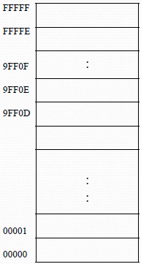
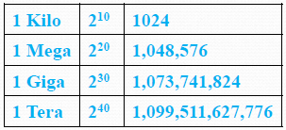
Memory locations and addresses cont...
Accessing the memory to store or retrieve a single item of information, either a word or a byte, requires distinct names or addresses for each item location.
➢ It is customary to use numbers from 0 through 2k - 1, for some suitable value of k, as the addresses of successive locations in the memory.
➢ The memory can have up to 2k addressable locations.
➢ For example, a 24-bit address generates an address space of (16,777,216) locations. This number is usually written as
16M (16 mega)
➢ A 32-bit address creates an address space of 232 or 4G (4 Giga) locations.

Slide 24
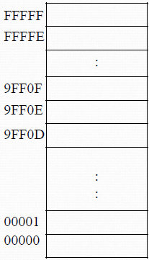
IA-32 Memory Management
IA-32 manages memory according to the basic modes of operation:
1. Real-Address mode
1 MB (1,048,576 byte) RAM maximum addressable using 20-bit addresses from hexadecimal 00000 to FFFFF.
But the original 8086 processor had only l6-bit registers so it was impossible to directly represent a 20 -bit address.
They came up with a scheme known as segmented memory.

Slide 25
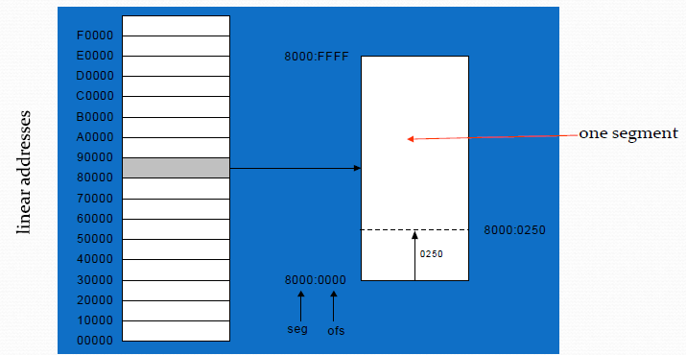
Segmented Memory
Segmented memory addressing: absolute (linear) address is a combination of a 16-bit segment value added to a 16-bit offset.
All of memory is divided into 64-kilobyte units called segments.

Slide 26
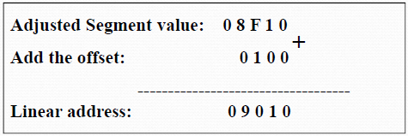
Calculating Linear Addresses
Given a segment address, multiply it by 10h (add a hexadecimal
zero), and add it to the offset
Example:
  convert 08F1:0100 to a linear address

Slide 27


Calculating Linear Addresses cont...
Always use hexadecimal notation for addresses.

Slide 28
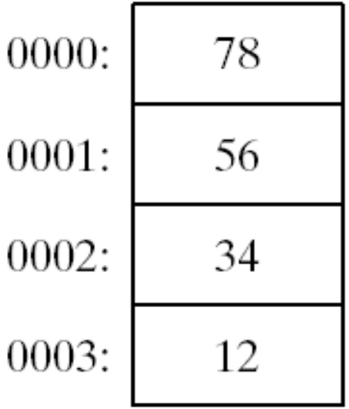
Little Endian Order
Intel processors store and retrieve data from memory using what is referred to as little endian order. This means that the least significant byte of a variable is stored at the lowest address. The remaining bytes are stored in the next consecutive memory positions.
Example:
  Consider the doubleword 12345678h. If placed in memory at offset 0
  78h would be stored in the first byte.
  56h would be stored in the second byte, and
  the remaining bytes would be at offsets 3 and 4,
  as the following diagram shows:

Slide 29
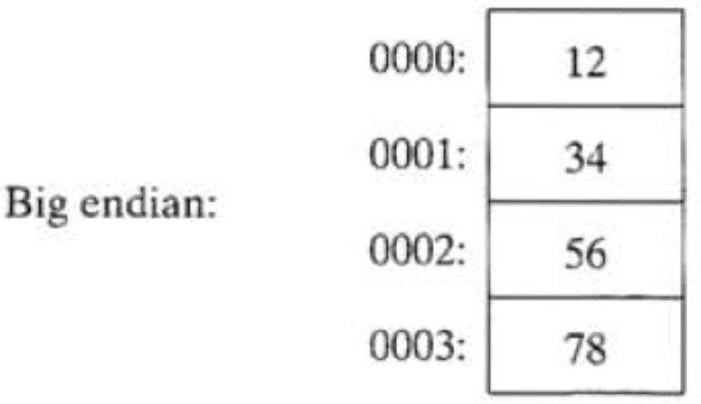
Big Endian Order
Big endian order (high to low). The following figure Shows an example of 12345678h stored in big endian order at offset 0:

Slide 30


